Slide 1
EV Remote Internship Project Report
Created by
Bharath, Simulation Engineer
Project Name
Student Electric Racing Vehicle
Case Studies: Race Track Drive Cycle

Slide 2
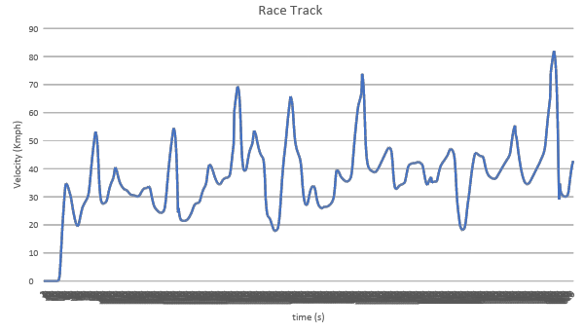
Race Track Drive Cycle

Slide 3
Model Inputs
Parameters | Values | Units
Rolling Resistance Force
Coefficient of rolling resistance | 0.015
Gross Vehicle Mass | 320 | Kg
Gravity constant | 9.81 | m/s
Gradient Force
Gross Vehicle Mass | 320 | Kg
Grade Angle | 0 | degree
Degrees to radians conversion factor | pi/180
Aerodynamic Force
Velocity | From the Drive Cycle data | Kmph
Kmph to mps conversion factor | 1000/3600 | mps
Constant | 0.5
Area | 1.8585 | m^2
Air Density | 1.225 | Kg/m^3
Drag Coefficient | 0.15
Parameters | Values | Units
Acceleration Force
Gross Vehicle Mass | 320 | Kg
Kmph to mps conversion factor | 1000/3600 | mps
Wheel Speed
Radius of wheel | 0.2286 | m
Transmission
Gear Ratio | 15
Transmission Efficiency | 85 | %
Motor
Motor Efficiency | 90 | %
Battery
Motor Controller Efficiency | 85 | %
Battery Voltage | 540 | V
Drive cycle distance | 0.825 | Km
No of Laps | 12
Battery Initial SOC | 100 | %
Drive Cycle time or Simulation time | 82 | s

Slide 4
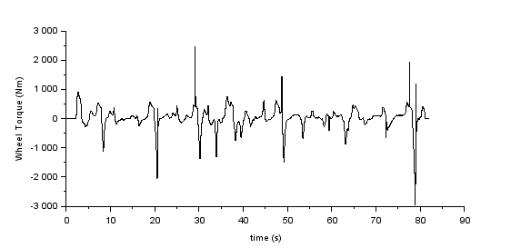
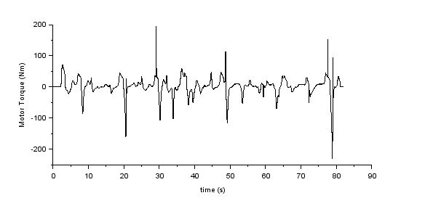
Wheel and Motor Torque
Wheel Torque
Motor Torque

Slide 5
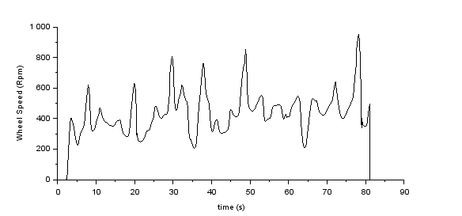
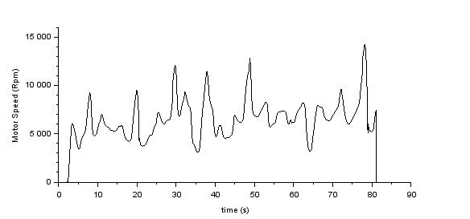
Wheel and Motor Speed
Wheel Speed
Motor Speed

Slide 6
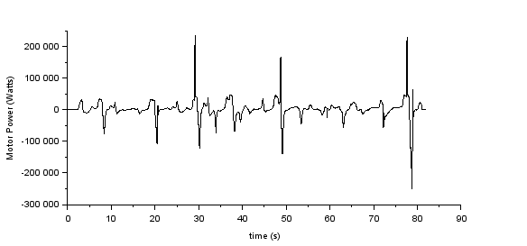
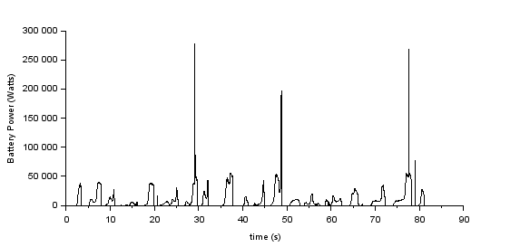
Motor and Battery Power
Motor Power
Battery Power

Slide 7
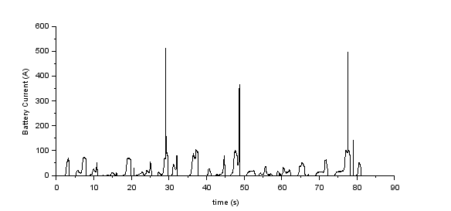
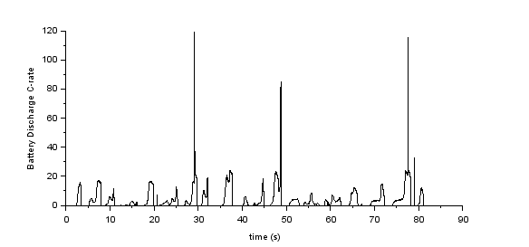
Battery Current and Battery Discharge C-rate
Battery Current
Battery Discharge C-rate

Slide 8
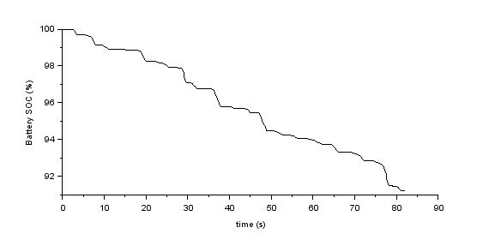
Battery State of Charge

Slide 9
Results
Sl No | Parameters | Value | Units
1 | Power per Km | 233.5 | Wh/km
2 | Range | 9.9 | Km
3 | Battery Capacity | 2311.7 | Wh
4 | No of cells | 122 (S), 1 (P)

Slide 10
Thank you
Email-id :
Mobile no.:

